Slide 1

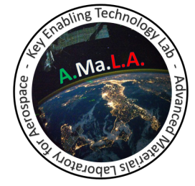
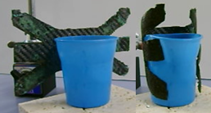
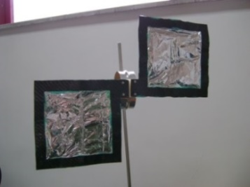
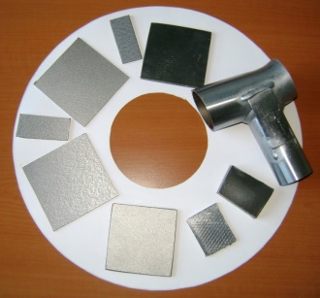

Technologies and Manufacturing Systems
Research Team TSL-IND
Research Topics
Materials for space applications
Composites and SMART materials
  Shape memory foams and composites
  Shielding materials
Non-conventional processes and machining
Polymer processing
Manufacturing process simulation
Metal and polymer foams
Materials characterization
Materials recycling technologies and circular economy
Aesthetic technologies
Industrial Sustainability
Contact
Prof. Loredana Santo
Tel. +39 06 7259 7165 loredana.santo@uniroma2.it

