Slide 1
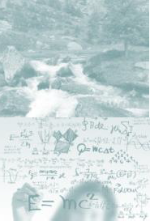
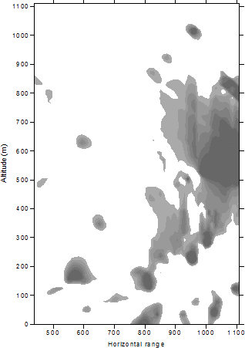
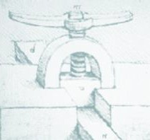
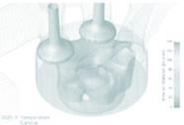
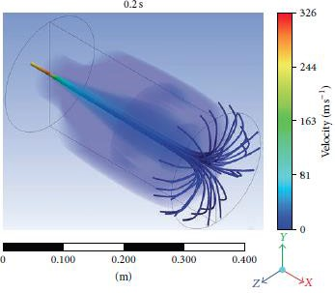
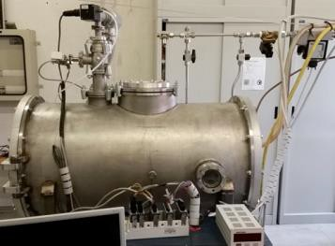
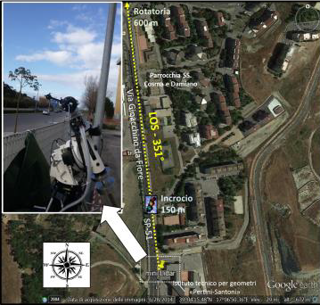
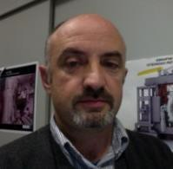
Quantum Electronic and Plasma Physics
DEPARTMENT OF
INDUSTRIAL ENGINEERING
Research Team
Research Topics
Laser System for Environmental monitoring
Develop of Laser based on Lidar and Dial technologies
Pollutants monitoring
Chemical aggressive gas identification
Fire detection
Pollutants detection
Nuclear Fusion
Safety and Security – STARDUST U project;
Big data analysis and data mining
Numerical simulation of physics phenomena
CBRNe Research
Contact
Prof. Pasquale Gaudio Tel. +39 06 72597209
Mobile +39 3204257014
gaudio@ing.uniroma2.it; www.qepresearch.it
Department of Industrial Engineering University of Rome Tor Vergata
Via del Politecnico, 1 00133 Rome, Italy

