Slide 1
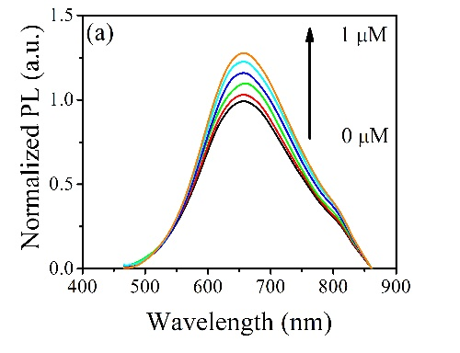
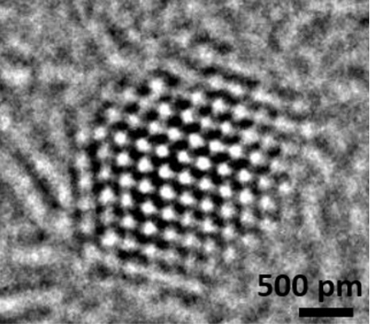
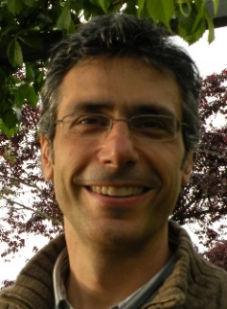
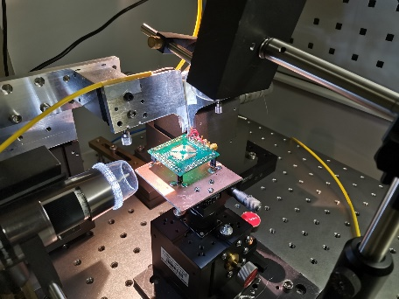
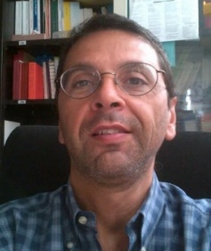
New Materials for Optoelectronics (NeMO)
Webpage: webnemo.uniroma2.it Research Topics
Optical Sensing of heavy metals in water
Ag and Au Nanoparticles and Nanoclusters
Fluorescent Graphene Oxide Quantum Dots
Silicon Photonics for ICT and Quantum Technologies
Silicon Photonic Bio-Sensors
3D-printing for Bio-Scaffolds
Contact
Prof. Paolo Prosposito
Tel. +39 0672594115/4779
paolo.prosposito@uniroma2.it
Prof. Fabio De Matteis
Tel. +39 0672594521
fabio.dematteis@roma2.infn.it
Foto

